Slide 1
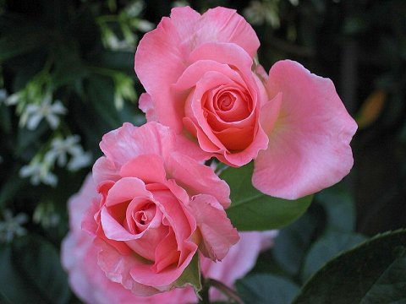
PLANT / ANIMAL RELATIONSHIPS
Year 13 Biology

Slide 2
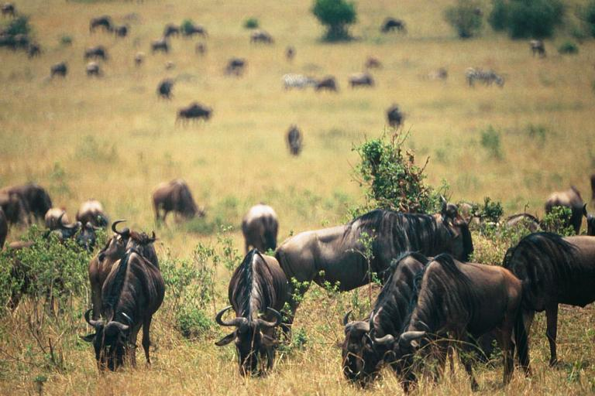
Herbivory
Grazers

Slide 3
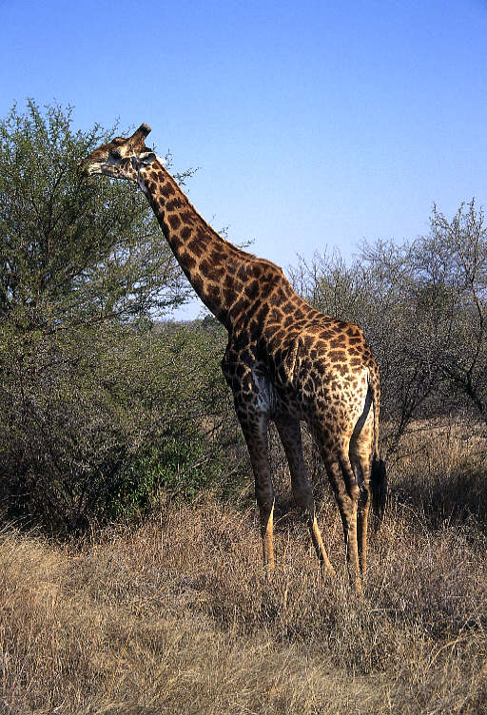
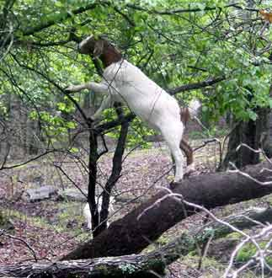
Browsing

Slide 4
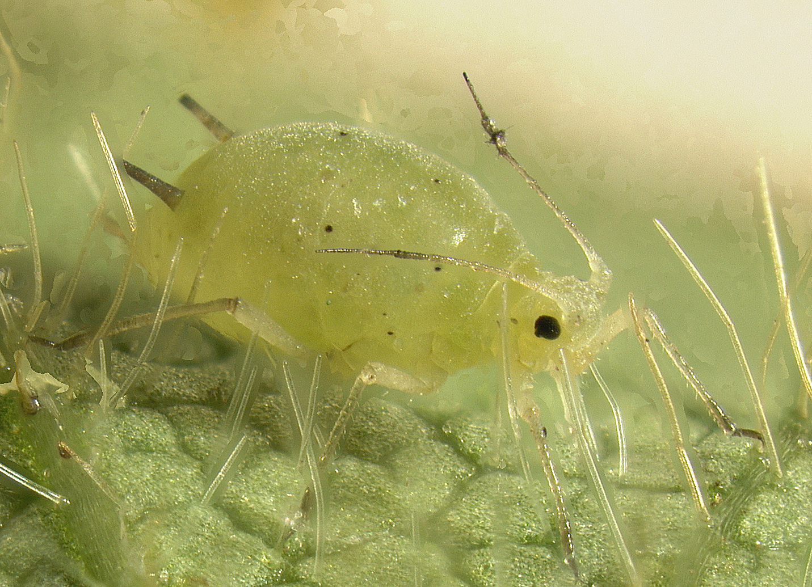
Sap Sucker - aphid

Slide 5
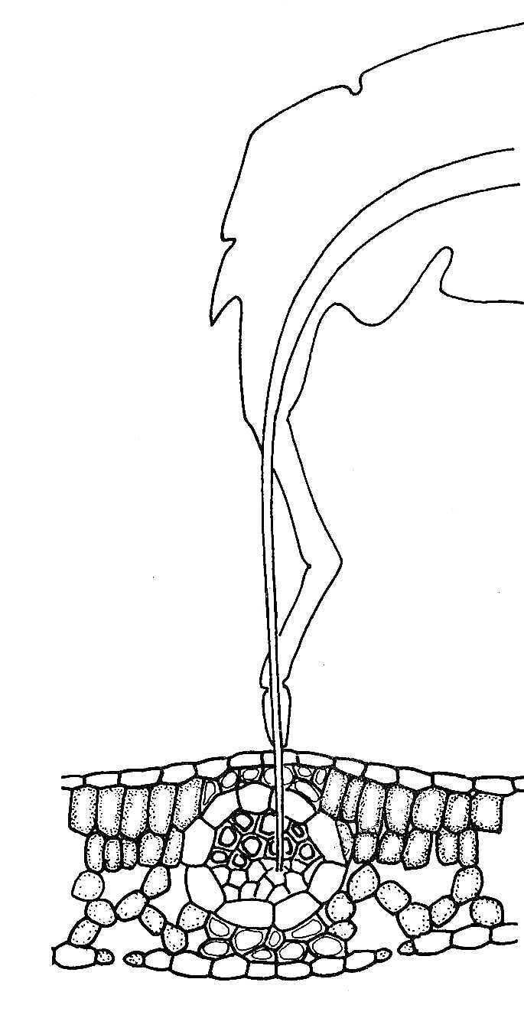
Sucker!

Slide 6
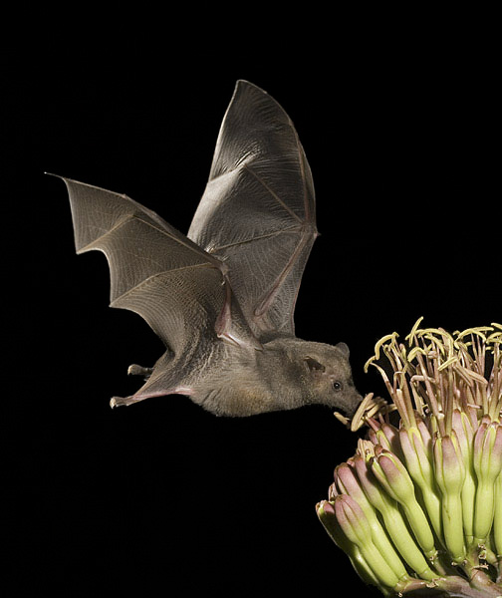
Nectar feeders
Bat

Slide 7
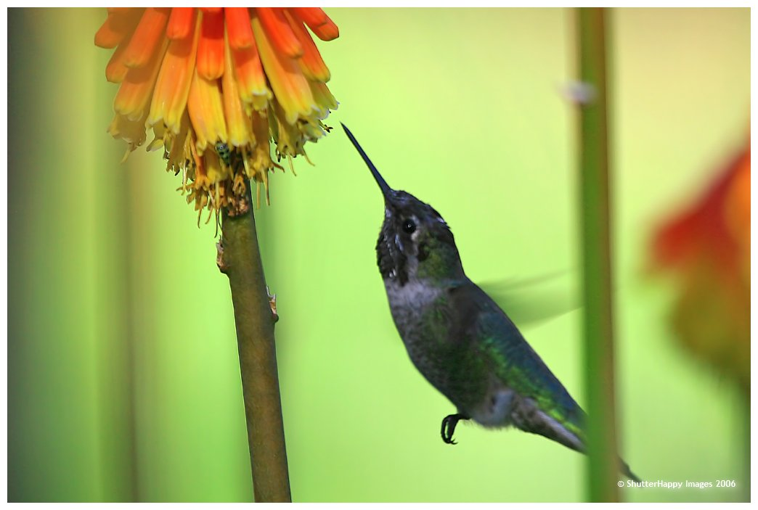
Humming bird

Slide 8
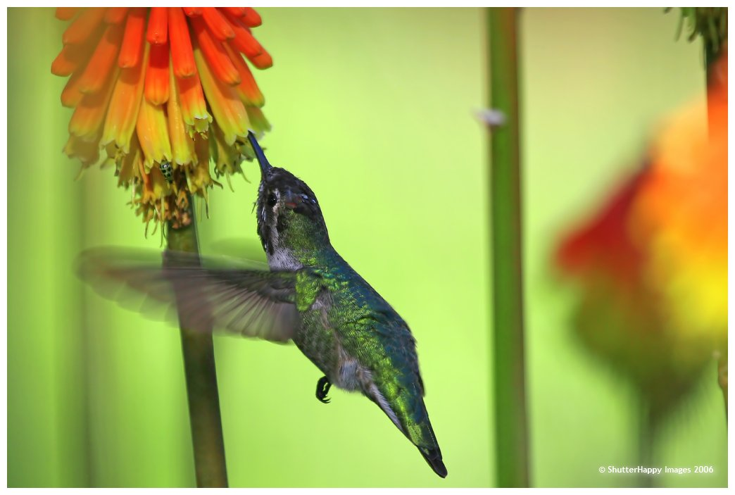

Slide 9
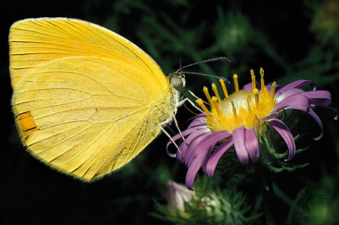
Butterfly

Slide 10
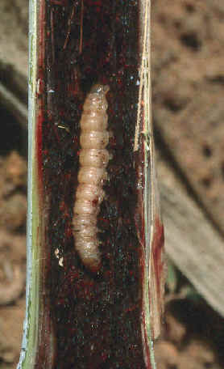
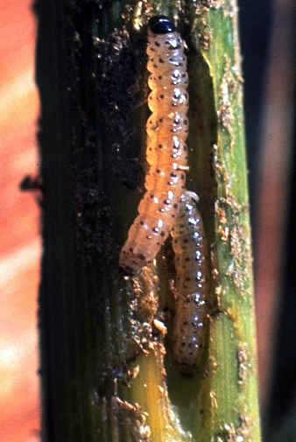
What a borer! Stem borer that is

Slide 11
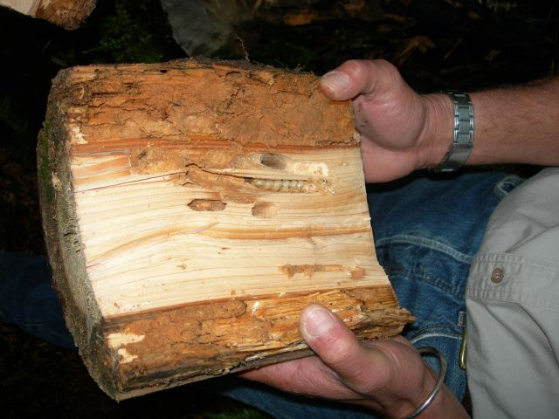
Huhu grubs

Slide 12
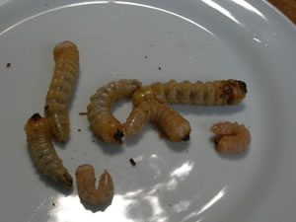
Yummy

Slide 13
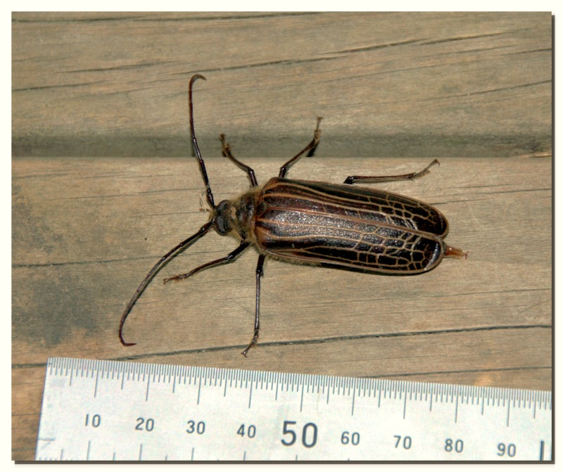
Adult huhu beetle

Slide 14
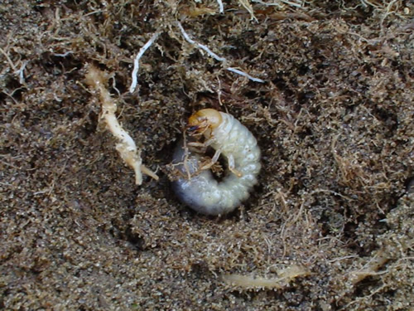
Root chewers – grass grub

Slide 15
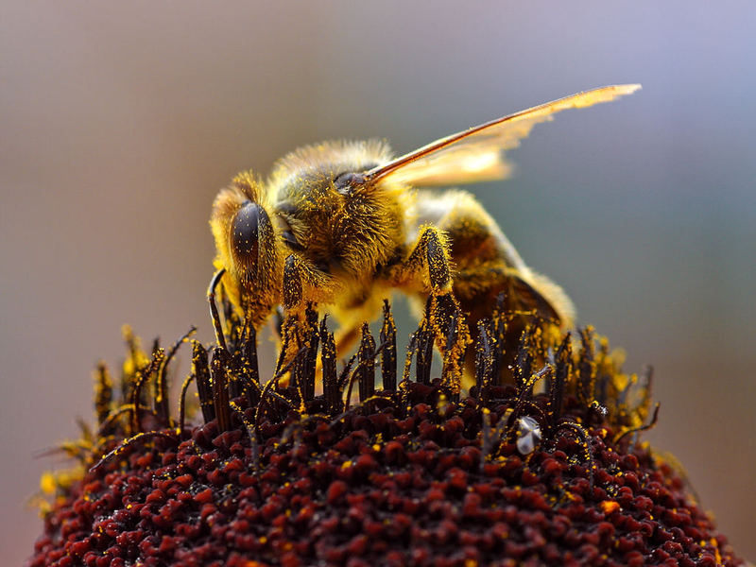
Pollen feeder - Bee

Slide 16
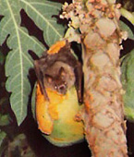
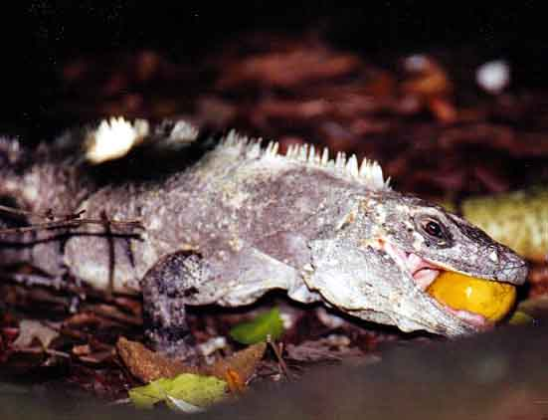
Fruit eaters
Bat Iguana

Slide 17
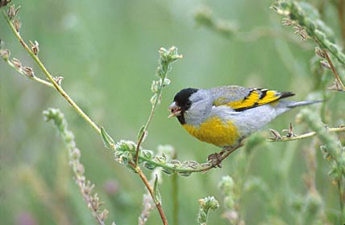
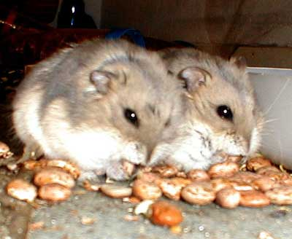
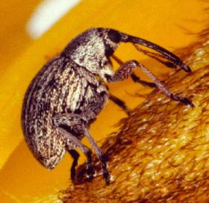
Seed eaters

Slide 18
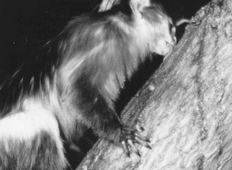
Gum eater
Black-tailed marmoset licking gum that is
dripping down a tree limb.

Slide 19
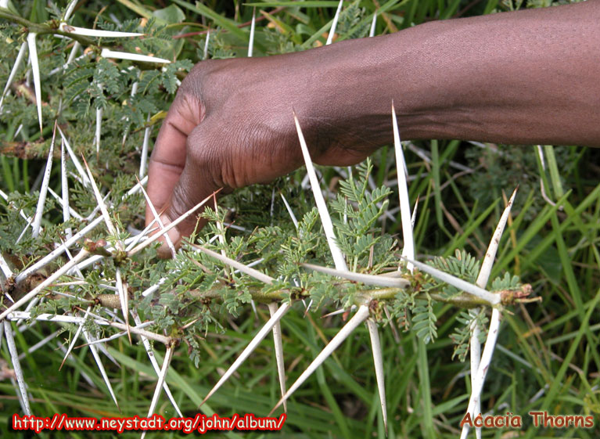
Plant defences
Thorns!

Slide 20
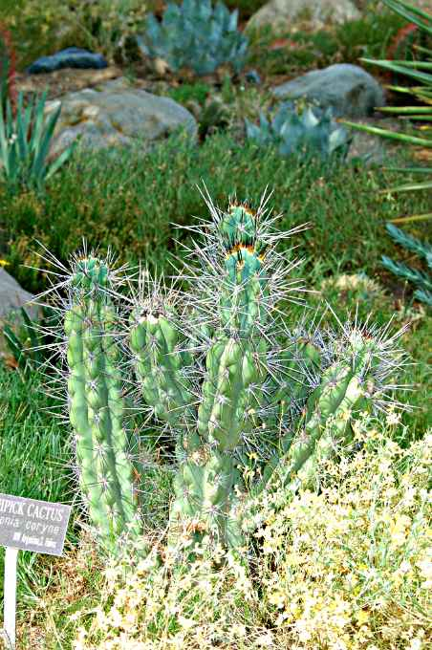
More thorns

Slide 21
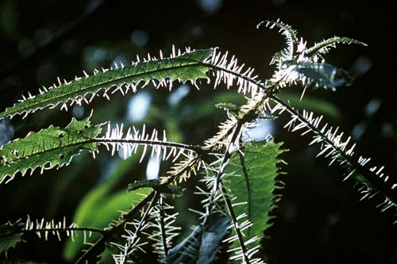
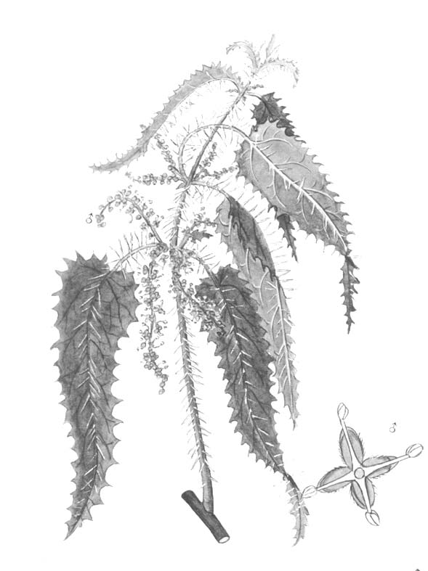
Ongaonga – not just thorns – poison ones!
People have died when they fell into stinging nettle!

Slide 22
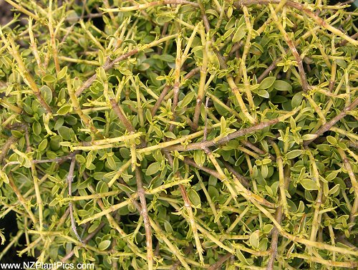
Divarication - Coprosma

Slide 23
Divarication
Very common in NZ shrubs and young trees
Short, strong, much-branching twigs
Leaves on the “inside”
Hard for herbivores to get at
Could be a result of natural selection by moa browsing

Slide 24
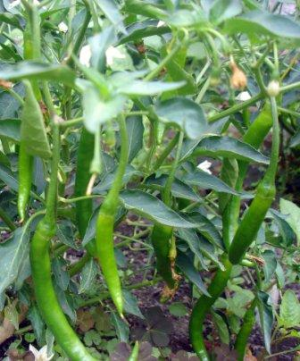
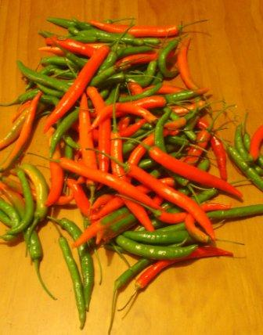
Chemicals
Chillies form antibiotics against bacteria

Slide 25

Boy – you find some interesting things when you search for chillies!

Slide 26
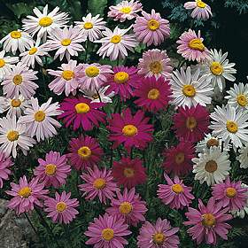
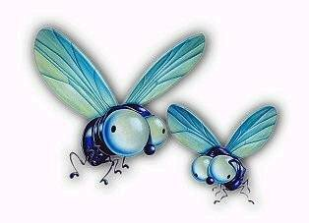
Pyrethrin daisy
Ahrrg - pyrethrin

Slide 27
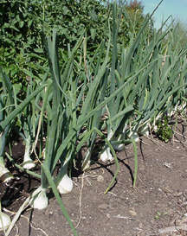
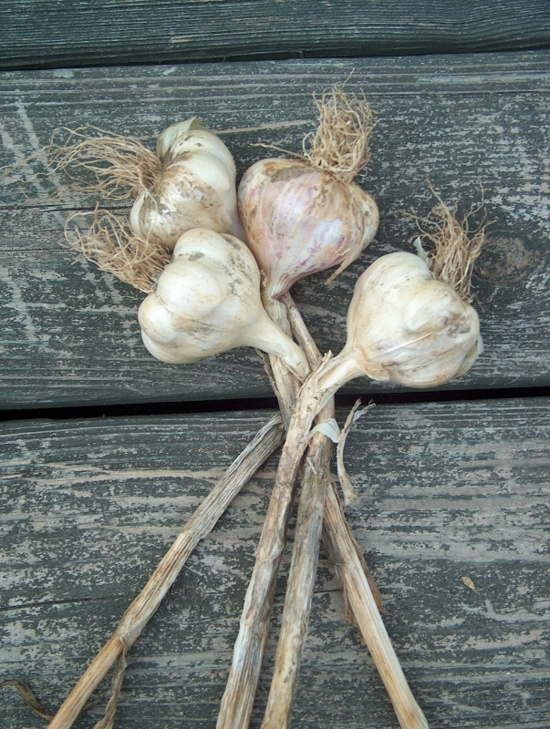
Smelly plants
Onions Garlic

Slide 28
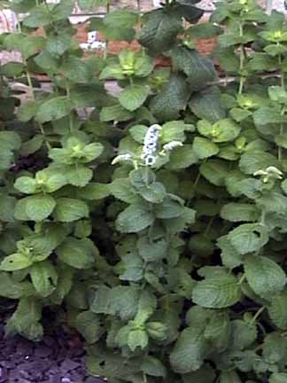
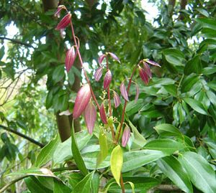
Peppermint Cinnamon

Slide 29
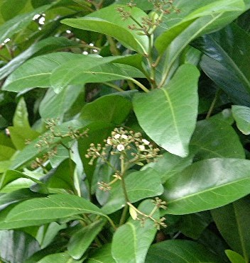
Parapara – Birds beware!

Slide 30
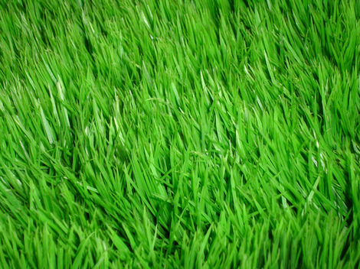
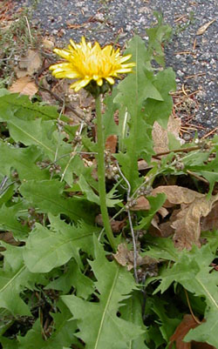
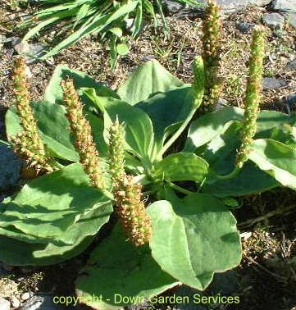
Low growing point –grass, dandelion, plantain

Slide 31
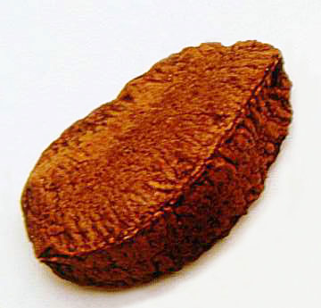
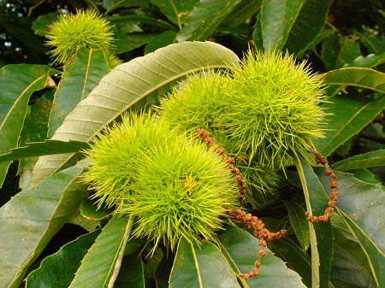
Protected seeds
Hard shell (Brazil nut) Prickles (Chestnut)

Slide 32
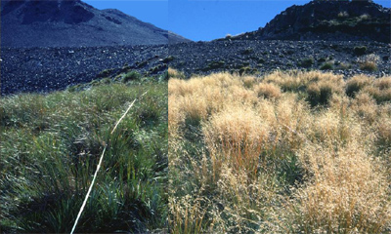
Seed masting in tussock
low year (2001) high year (1999)

Slide 33
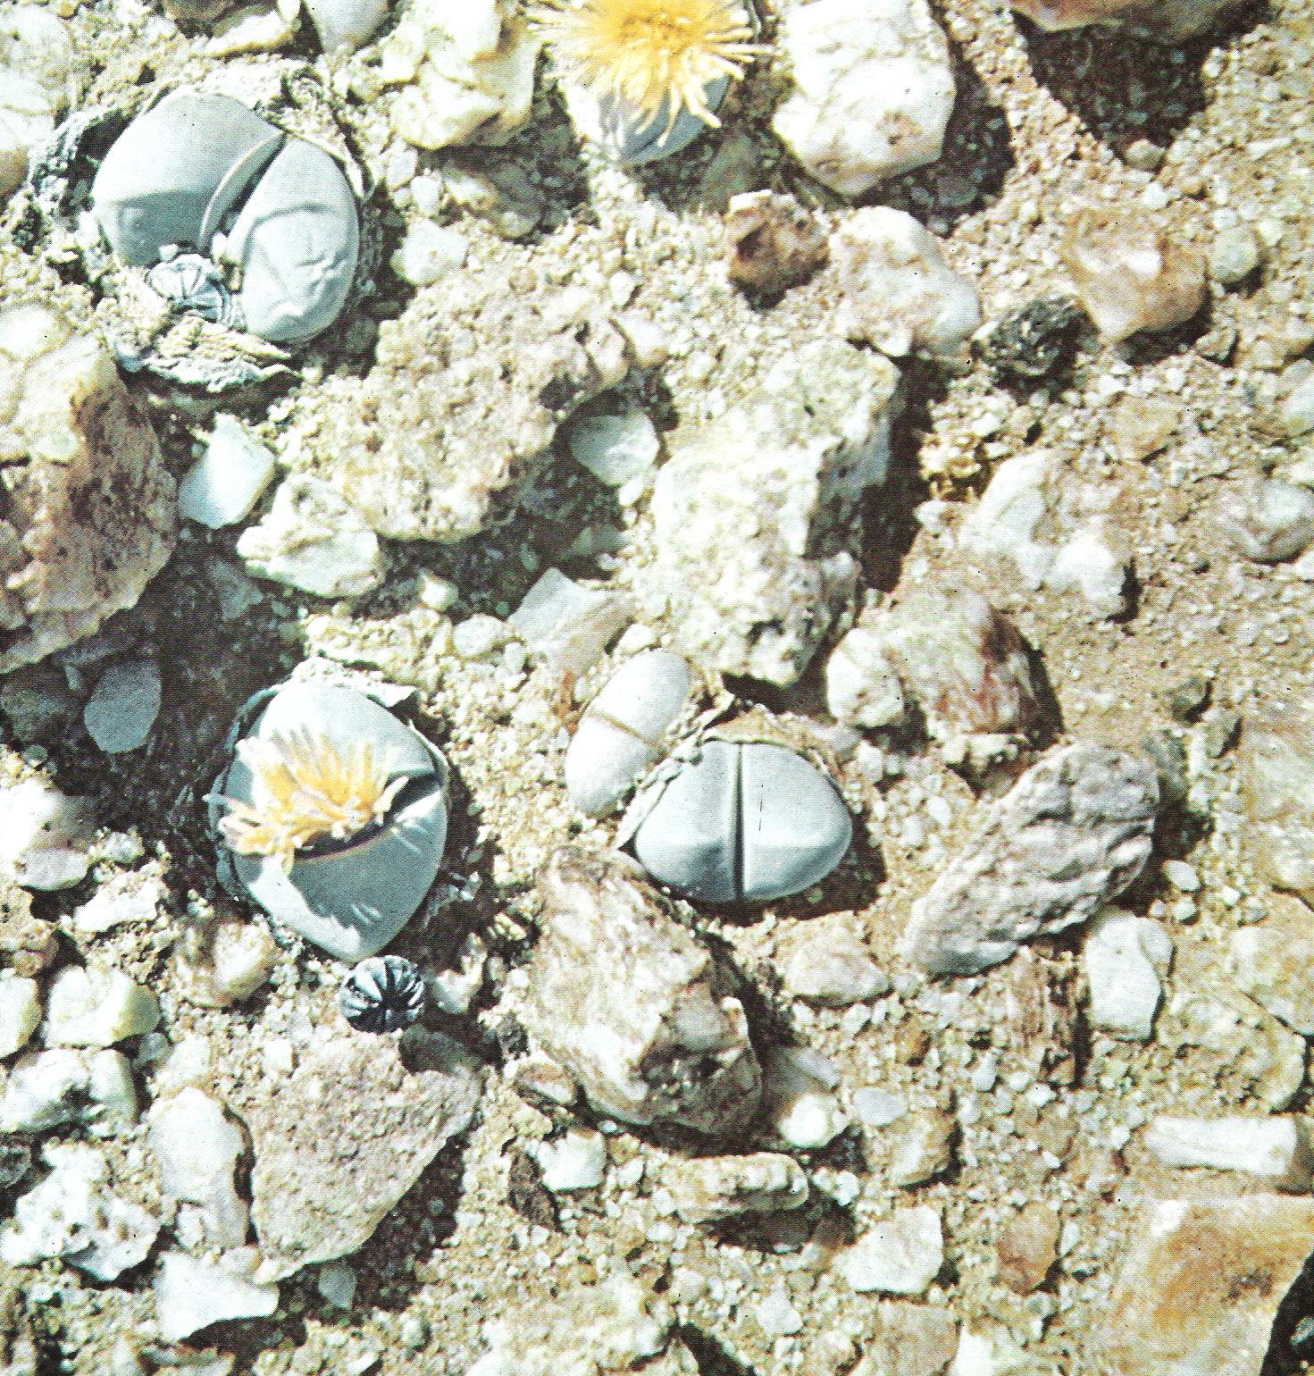
Plants hiding - Peekaboo!
Flowers are a bit of a giveaway!

Slide 34
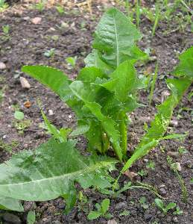
Regeneration
This dandelion has regenerated from a piece of root left on the ground

Slide 35
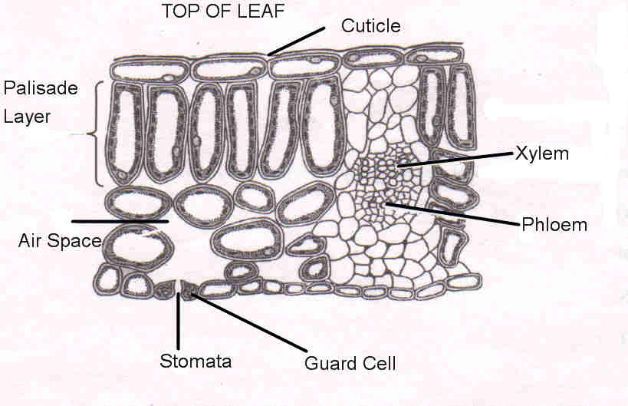
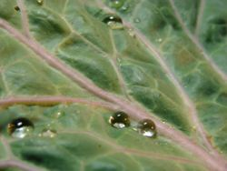
Waxy cuticle
Note how the waxy cuticle on this kale plant repels water – and makes it hard for pathogens to enter

Slide 36
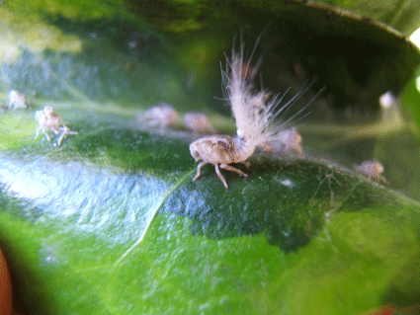
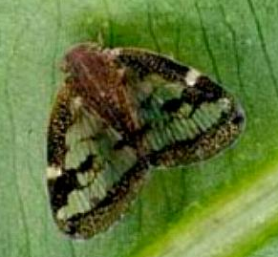
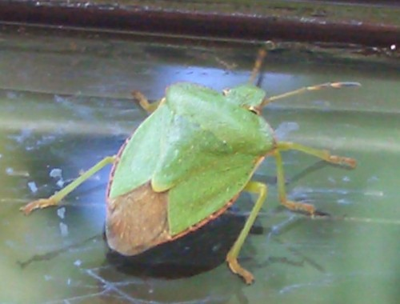
Which is ok until one of these little bug***s pierces it

Slide 37
Co-operation between plants
One plant may protect nearby plants
Eg-

Slide 38

Marigold roots secrete nematode- killing chemicals, (and they are pretty too)!

Slide 39



Willows and alders warn neighbours of insect attack
Alder
Willow
Thanks dude!
Hey mate!
Watch out!
Alder leaf

